Slide 1
Routing– Unit 3
Border Gateway Protocol (BGP)
S.V.Jansi Rani
Assistant Professor / CSE
Notes:
The University of Adelaide, School of Computer Science
Chapter 2 — Instructions: Language of the Computer

Slide 2
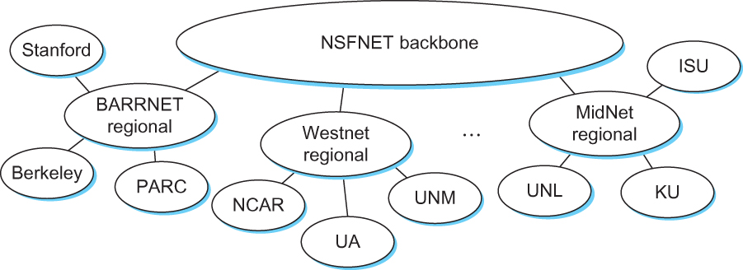
The Global Internet
The tree structure of the Internet in 1990
Notes:
The University of Adelaide, School of Computer Science
Chapter 2 — Instructions: Language of the Computer

Slide 3
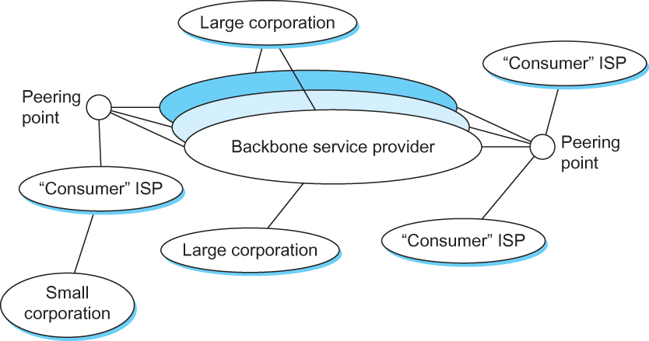
The Global Internet
A simple multi-provider Internet
Notes:
The University of Adelaide, School of Computer Science
Chapter 2 — Instructions: Language of the Computer

Slide 4
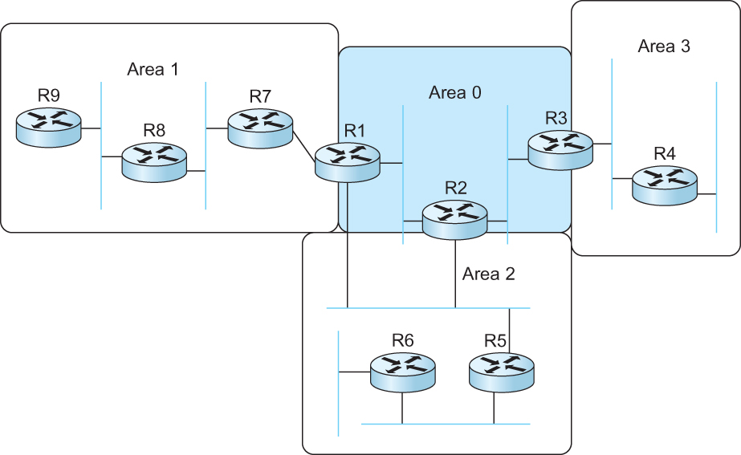
Routing Areas
Backbone area
Area border router (ABR)
A domain divided into area

Slide 5
Interdomain Routing (BGP)
Internet is organized as autonomous systems (AS) each of which is under the control of a single administrative entity
Autonomous System (AS)
  corresponds to an administrative domain
  examples: University, company, backbone network
A corporation’s internal network might be a single AS, as may the network of a single Internet service provider

Slide 6
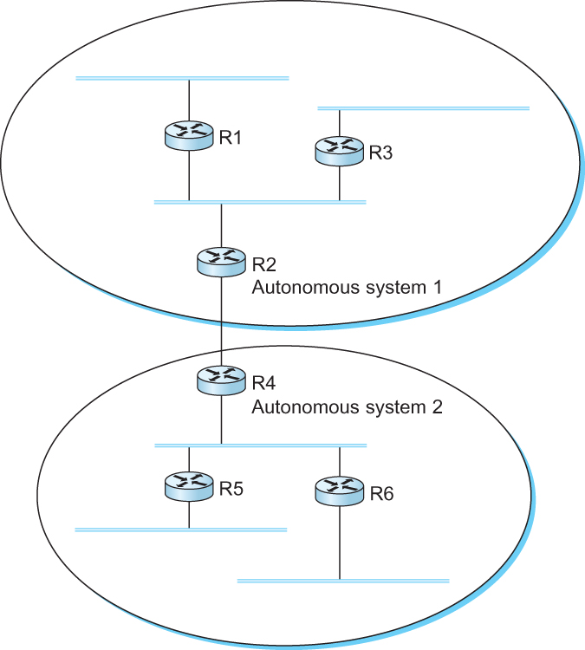
Interdomain Routing
A network with two autonomous system

Slide 7
Route Propagation
Idea: Provide an additional way to hierarchically aggregate routing information is a large internet.
  Improves scalability
Divide the routing problem in two parts:
  Routing within a single autonomous system
  Routing between autonomous systems
Autonomous systems / Routing domains
  Two-level route propagation hierarchy
    Inter-domain routing protocol (Internet-wide standard)
    Intra-domain routing protocol (each AS selects its own)

Slide 8
EGP and BGP
Inter-domain Routing Protocols
  Exterior Gateway Protocol (EGP)
    Forced a tree-like topology onto the Internet
    Did not allow for the topology to become general
      Tree like structure: there is a single backbone and autonomous systems are connected only as parents and children and not as peers
  Border Gateway Protocol (BGP)
    Assumes that the Internet is an arbitrarily interconnected set of ASs.
    Today’s Internet consists of an interconnection of multiple backbone networks (they are usually called service provider networks, and they are operated by private companies rather than the government)
    Sites are connected to each other in arbitrary ways

Slide 9
BGP
Some large corporations connect directly to one or more of the backbone, while others connect to smaller, non-backbone service providers.
Many service providers exist mainly to provide service to “consumers” (individuals with PCs in their homes), and these providers must connect to the backbone providers
Often many providers arrange to interconnect with each other at a single “peering point”

Slide 10
BGP-4: Border Gateway Protocol
Assumes the Internet is an arbitrarily interconnected set of AS's.
Define local traffic as traffic that originates at or terminates on nodes within an AS, and transit traffic as traffic that passes through an AS.
We can classify AS's into three types:
  Stub AS: an AS that has only a single connection to one other AS; such an AS will only carry local traffic (small corporation in the figure of the previous page).
  Multihomed AS: an AS that has connections to more than one other AS, but refuses to carry transit traffic (large corporation at the top in the figure of the previous page).
  Transit AS: an AS that has connections to more than one other AS, and is designed to carry both transit and local traffic (backbone providers in the figure of the previous page).

Slide 11
BGP
The goal of Inter-domain routing is to find any path to the intended destination that is loop free
  We are concerned with reachability than optimality
  Finding path anywhere close to optimal is considered to be a great achievement

Slide 12
BGP
Scalability: An Internet backbone router must be able to forward any packet destined anywhere in the Internet
  Having a routing table that will provide a match for any valid IP address
Autonomous nature of the domains
  It is impossible to calculate meaningful path costs for a path that crosses multiple ASs
  A cost of 1000 across one provider might imply a great path but it might mean an unacceptable bad one from another provid
Issues of trust
  Provider A might be unwilling to believe certain advertisements from provider B

Slide 13
BGP
Each AS has:
One BGP speaker that advertises:
  local networks
  other reachable networks (transit AS only)
  gives path information
In addition to the BGP speakers, the AS has one or more border “gateways” which need not be the same as the speakers
The border gateways are the routers through which packets enter and leave the AS

Slide 14
BGP
BGP does not belong to either of the two main classes of routing protocols (distance vectors and link-state protocols)
BGP advertises complete paths as an enumerated lists of ASs to reach a particular network – Path Vector Protocol

Slide 15
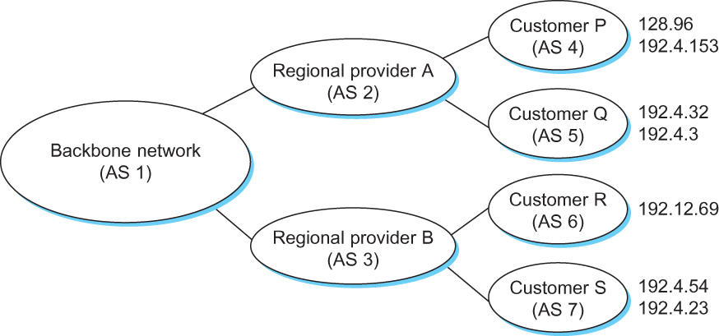
BGP Example
Example of a network running BGP

Slide 16
BGP Example
Speaker for AS 2 advertises reachability to P and Q
  Network 128.96, 192.4.153, 192.4.32, and 192.4.3, can be reached directly from AS 2.
Speaker for backbone network then advertises
  Networks 128.96, 192.4.153, 192.4.32, and 192.4.3 can be reached along the path <AS 1, AS 2>.
Speaker can also cancel previously advertised paths

Slide 17
BGP Issues
It should be apparent that the AS numbers carried in BGP need to be unique
For example, AS 2 can only recognize itself in the AS path in the example if no other AS identifies itself in the same way
AS numbers are 16-bit numbers assigned by a central authority

Slide 18
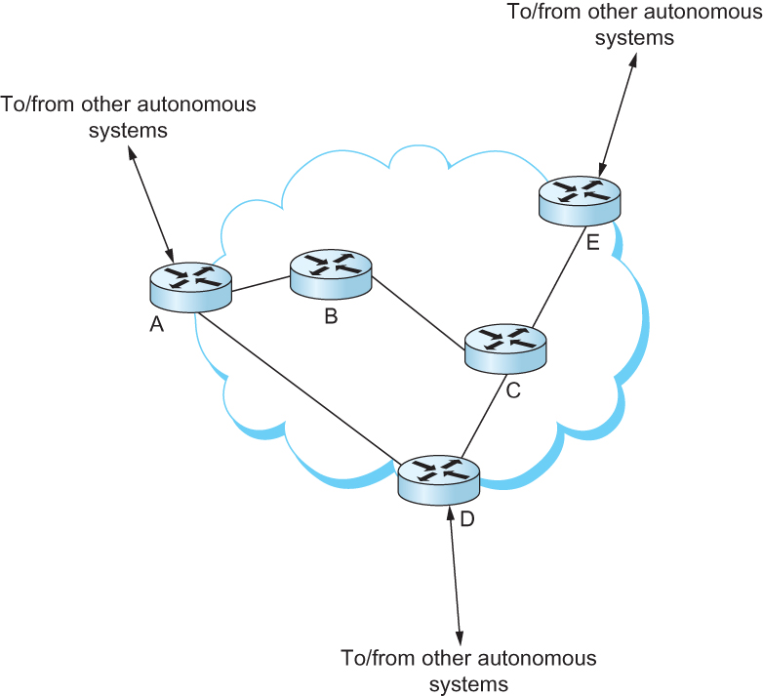
Integrating Interdomain and Intradomain Routing
All routers run iBGP and an intradomain routing protocol. Border routers (A, D, E) also run eBGP to other ASs

Slide 19
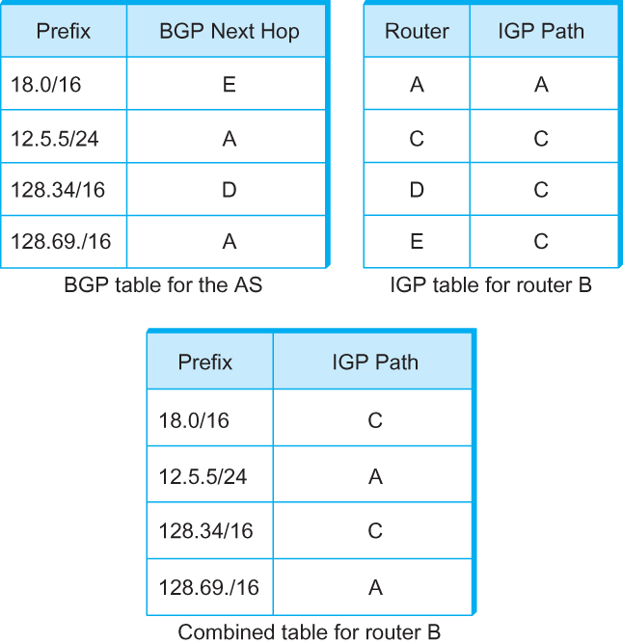
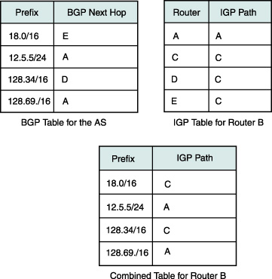
Integrating Interdomain and Intradomain Routing
BGP routing table, IGP routing table, and combined table at router B

Slide 20
THANK YOU
Notes:
The University of Adelaide, School of Computer Science
Chapter 2 — Instructions: Language of the Computer

